Slide 1


MUSIC PLAYER
This Project & Presentation is for partial fulfilment of
Front End Engineering - II(22CS004)
Submitted By :
CSE-G7(Team 17)
Keshav (2210990502)
Goransh Handa(2210990329)
Khushi Bansal(2210990510)
Khushi Verma(2210990514)
Presented To :
Dr. Parul gahelot
Mr. Vikas Patel
Department of Computer Science and Engineering
Chitkara University, Punjab

Slide 2

Table of content
Introduction
3
Meet our Team
5
Technical Details
6
Key Features
7
Project Highlight
8
Future Goals
15
Conclusion
16

Slide 3
Introduction
Welcome to V-music, your all-in-one solution for enjoying your favorite media content! In today's fast-paced digital age, where entertainment is a cornerstone of our daily lives, having a reliable and feature-rich media player is essential. Whether you're listening to music, watching videos, or organizing your media library, V-music is designed to enhance your multimedia experience.
Why choose V-music ? Here are just a few reasons:
1.Versatile Media Support
2.Intuitive Interface
3.Customizable Playback
4.Enhanced Audio Experience
5.Seamless Integration
6.Cross-Platform Compatibility
Ready to experience the next level of media playback? Let the harmony of music and media enrich your life with V-music!

Slide 4


V-music PLAYER

Slide 5

Meet OUR team
KESHAV
HTML and CSS
Goransh handa
ReactJS
Khushi bansal
ReactJS
Khushi verma
Website designing

Slide 6
Technical Details
HTML :
The Hypertext Markup Language or HTML is standard markup language for documents designed to be displayed in a web browser.
CSS :
CSS or cascading style sheets is used for styling and formatting HTML documents. It is used to define styles for HTML elements such as fonts, colors, spacing and layout.
REACTJS :
React.js is a powerful JavaScript library used for building user interfaces, particularly for web applications with dynamic content.
VISUAL STUDIO CODE :
Visual studio code is a free and open-source code editor developed by Microsoft and is designed for building and debugging web and cloud applications.
API :
An API, or Application Programming Interface, is a set of rules and protocols that allows different software applications to communicate with each other

Slide 7
Key Features
1. Play Any File, Hassle-Free :
V-music effortlessly handles a wide range of audio and video formats, so you can enjoy your media without any worries.
2. Easy to Use :
Our player's simple interface lets you navigate your library, tweak settings, and explore advanced features with just a few clicks.
3. Immerse Yourself in Sound:
V-music enriches your listening with built-in equalizers, effects, and support for top-notch audio formats, ensuring every moment sounds amazing..
4. Everything in One Place:
Streamlined integration with popular services, online radios, and external devices means you can access all your favorites without switching apps.
5. Works Everywhere:
No matter your device—Windows, macOS, or Linux—V-music delivers a smooth experience across all major platforms.

Slide 8

V-music
Project Highlights

Slide 9
Sleek and Intuitive Interface:
media player features a modern and user-friendly interface designed for ease of use and seamless navigation, ensuring that users can access their media content effortlessly.
Comprehensive Media Format Support:
With support for a wide range of audio and video formats, our media player ensures that users can play virtually any type of media file without the need for additional plugins or codecs.
Enhanced Playback Features :
From customizable playlists and shuffle modes to advanced playback controls such as speed adjustment and audio equalization, our media player offers a plethora of features to enhance the user's listening and viewing experience.
Cross-Platform Compatibility:
Whether on Windows, macOS, or Linux, our media player is designed to work seamlessly across all major operating systems, providing a consistent experience for users regardless of their device preferences.
Enhanced Accessibility Features:
Our media player includes accessibility features such as customizable keyboard shortcuts, screen reader compatibility, and support for subtitles and closed captions, ensuring that it can be enjoyed by users of all abilities.

Slide 10
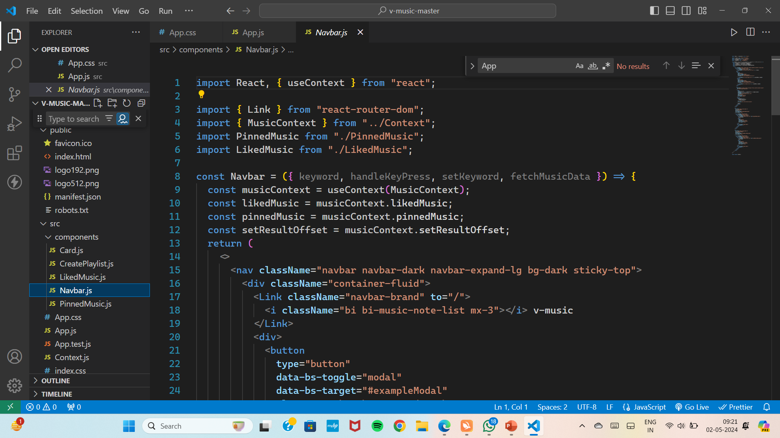
Code Snippets

Slide 11
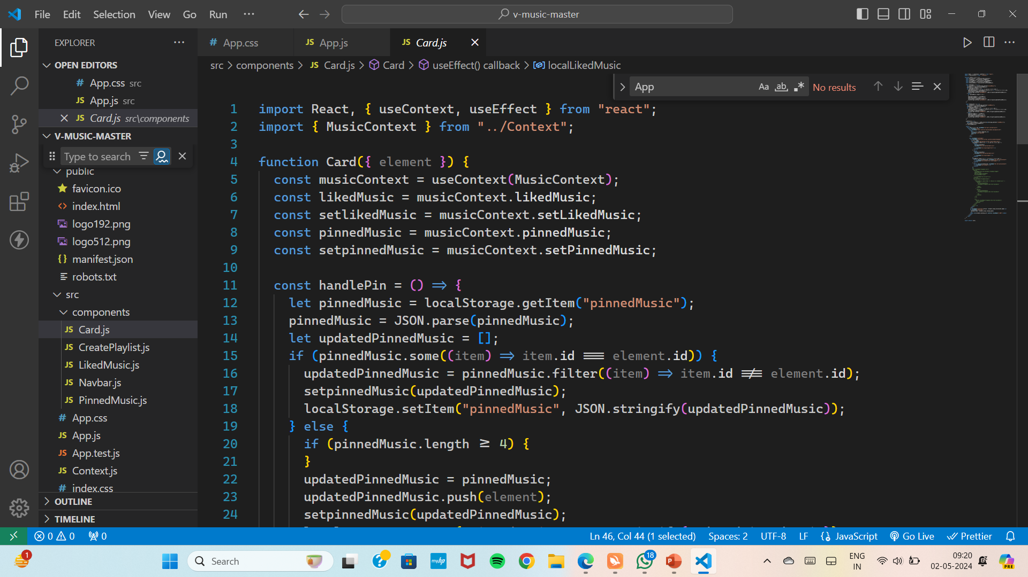

Slide 12
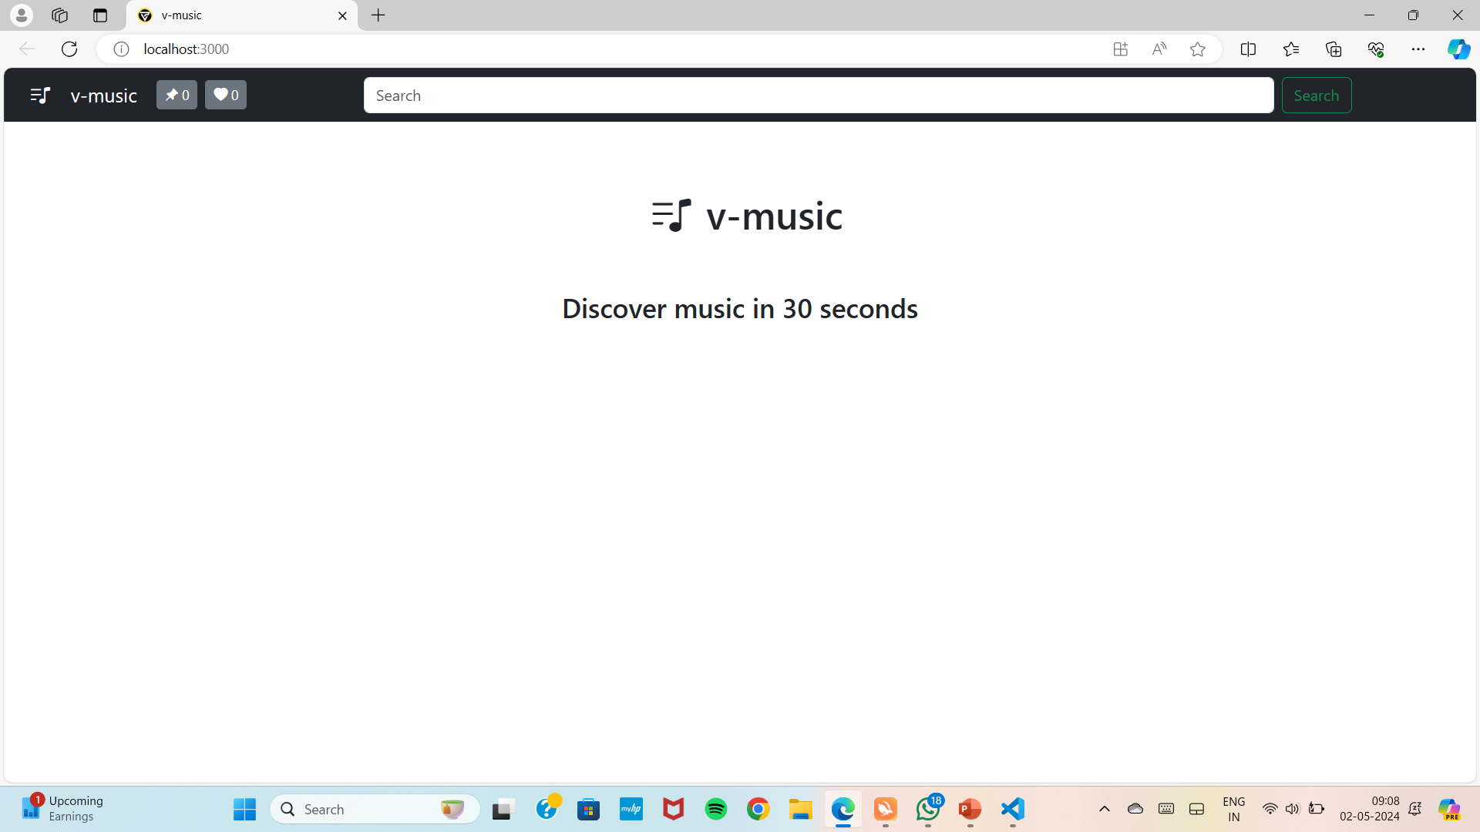
Website Snippets
Home Page

Slide 13
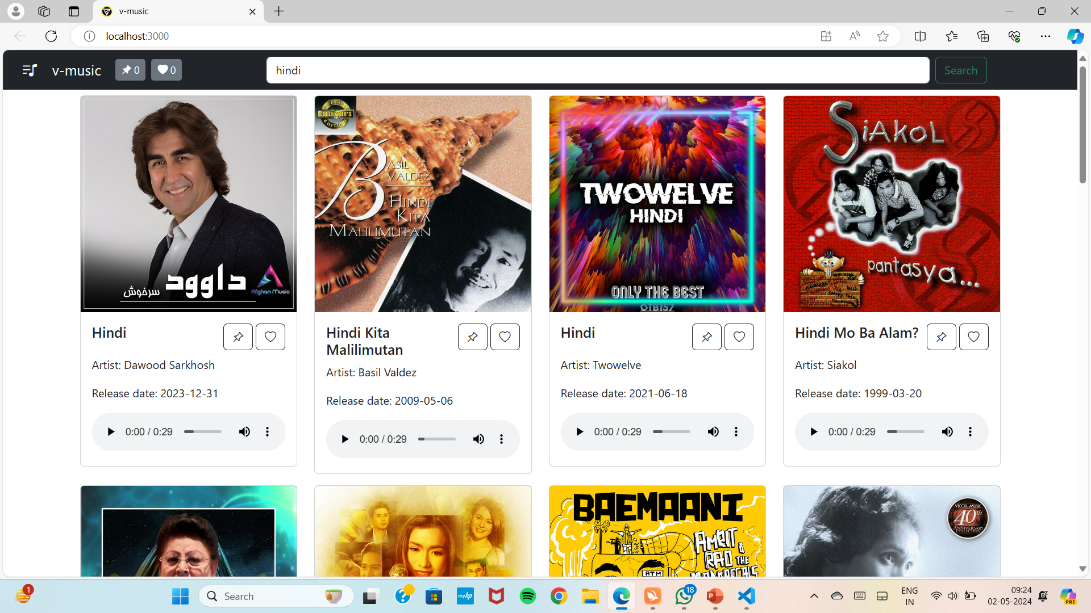
Hindi Songs

Slide 14
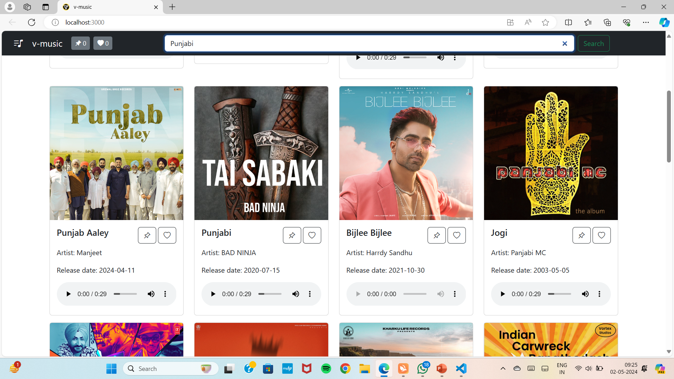
Punjabi Songs

Slide 15
Future Scope
Smart Home Integration:
As smart home technology continues to evolve, media players could integrate seamlessly with smart speakers, voice assistants, and other IoT devices to provide hands-free control and enhance the multimedia experience in the connected home environment.
Environmental and Contextual Awareness:
Media players could become more contextually aware, adapting their interface and functionality based on factors such as the user's location, activity, mood, and social context, to provide a more personalized and relevant experience.
Accessibility and Inclusivity:
Future media players should prioritize accessibility features to ensure that they can be used by individuals with disabilities or special needs, including support for screen readers, alternative input methods, and customizable interfaces.

Slide 16
Conclusion
Overall, our media player project offers a seamless and intuitive platform for users to enjoy their favorite music and videos. With support for diverse formats, customizable features, and seamless integration, it caters to the needs of modern media consumers. As technology evolves, we remain committed to enhancing our player's functionality and user experience, ensuring it remains a staple in the digital entertainment landscape.

Slide 17
Thank You!!

